Slide 1

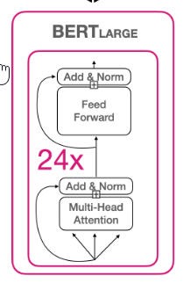
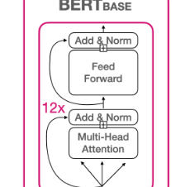


NLP with Disaster Tweets
Ravi Kumar N
Hareesh P R
Bhavya Joshi
Ashish Kota
Under the Guidance of:
Prof. Shirish Shevade, IISC
And
Ahamed Sanin, TalentSprint

Slide 2
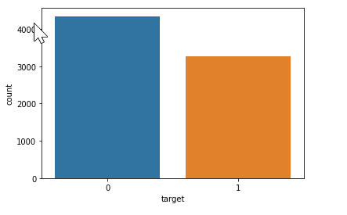
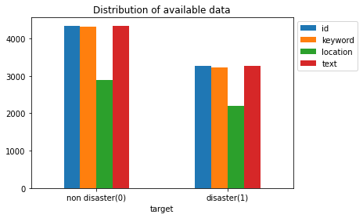
Dataset
7613 Tweets -Disaster Tweets: 3271 -Non-Disaster Tweets: 4342
222 Unique Keywords Missing: 0.8%
Location: 3342 unique values
33% Missing
Tweets: No missing data
Source: Kaggle Disaster Tweets Dataset

Slide 3
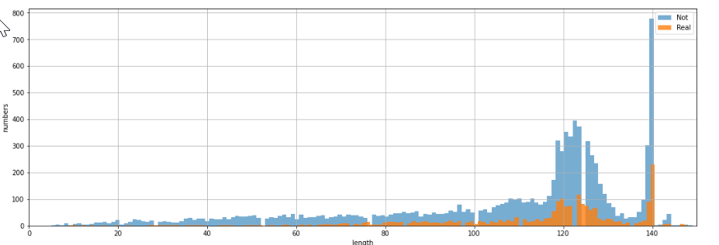
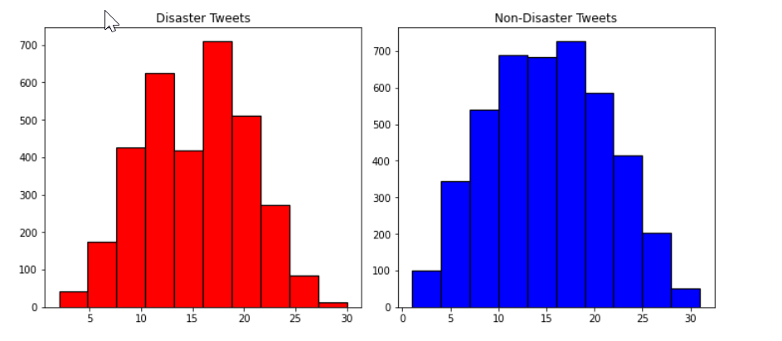
Characters count Disaster and non-disaster tweets are in the range of (120,160)
Number of words in text

Slide 4
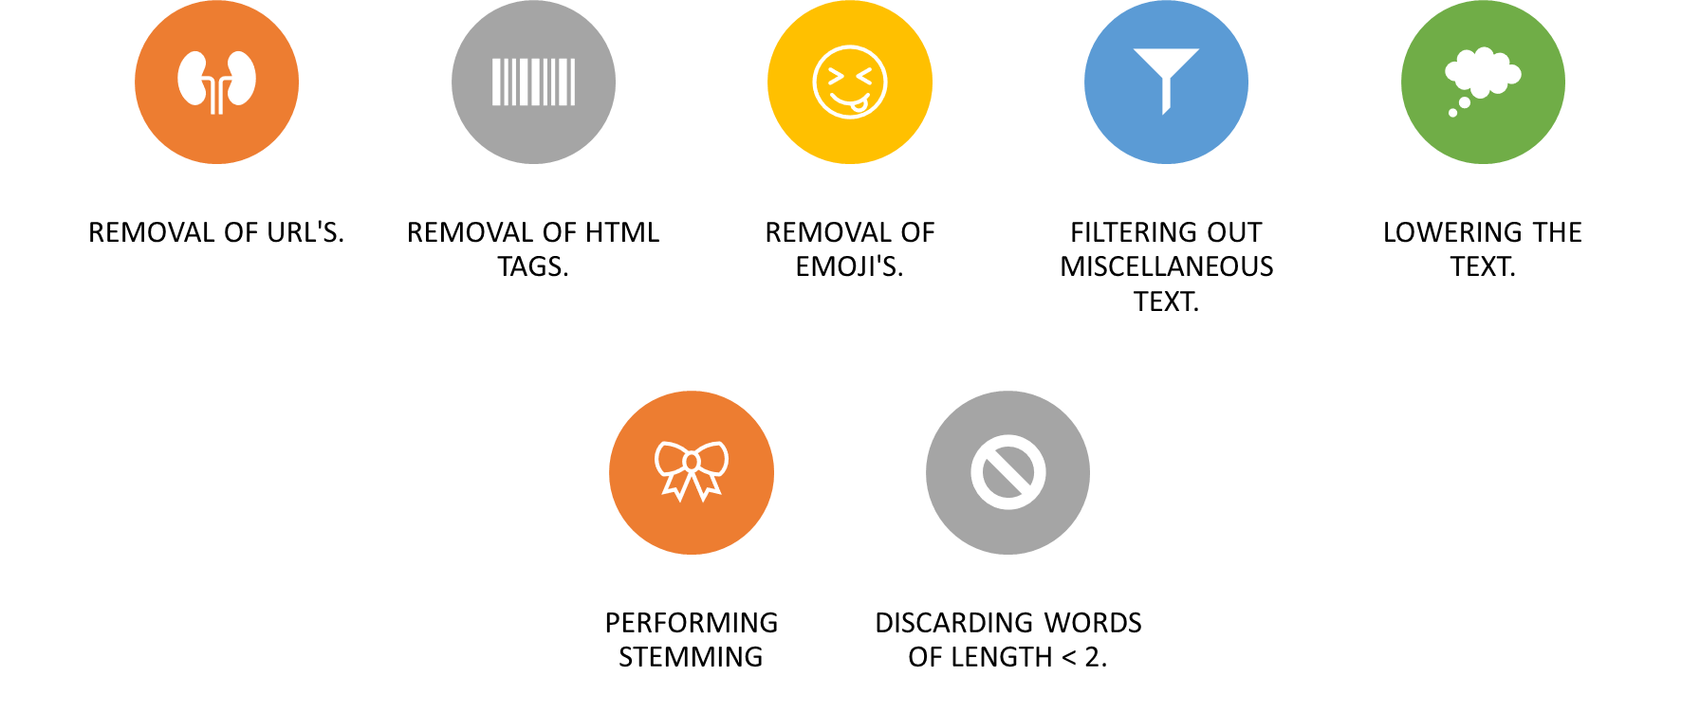
Preprocessing

Slide 5
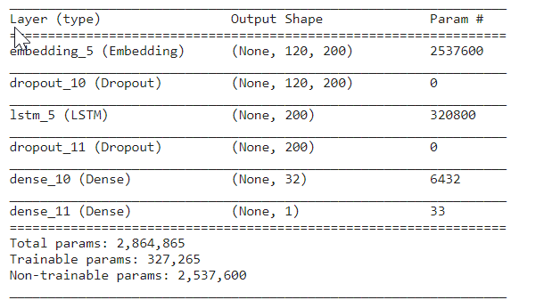
LSTM Model
Glove representation of 200D used to create a word embedding model
Activation functions - Hidden Layers : ReLU - Output Layer: Sigmoid
Dropout : 0.35
Batch size: 32
Loss: Binary Cross Entropy
Optimizer = Adam
Epochs = 30
Validation Split = 0.1
Learning Rate=1e-4

Slide 6
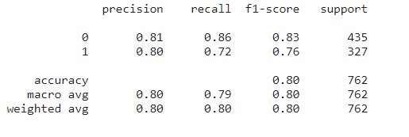
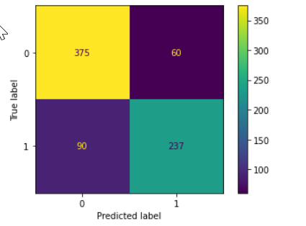
LSTM

Slide 7
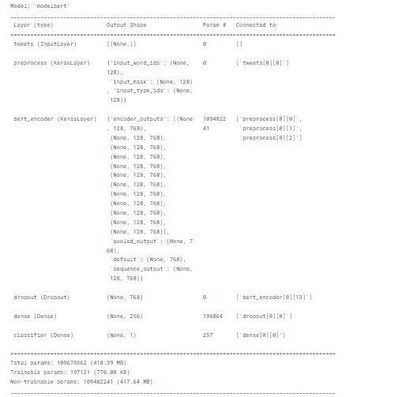
BERT- Model
Preprocesssor: bert_en_uncased_preprocess
Encoder: encoder bert_en_uncased_L-12_H-768_A-12/4
Activation functions - Hidden Layers : ReLU - Output Layer: Sigmoid
Dropout : 0.5
Loss: Binary Cross Entropy
Optimizer = AdamW
Epochs = 10
Validation Split = 0.1
Learning Rate=5e-5

Slide 8
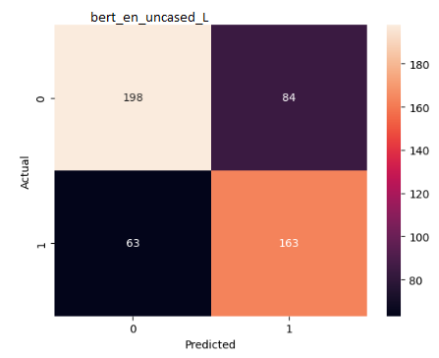
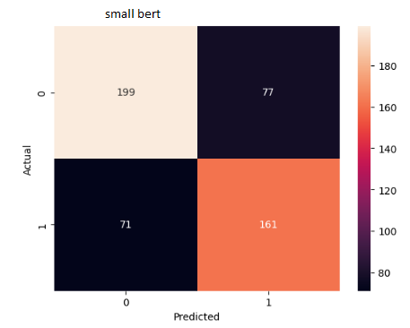


BERT

Slide 9
Model Comparison
Classifier | Precision | Recall | F1 Score
LSTM | 0.80 | 0.72 | 0.76
BERT L | 0.66 | 0.72 | 0.69
SMALL BERT | 0.68 | 0.69 | 0.69

Slide 10
Final Thoughts..
Data Pre-processing
Thorough analysis of the effects of other factors to be taken into account, such as location and keywords
Emoji to text categorization and effect assessment
Verify the significance of retweeting url about disasters.
Model Selection
A few other models, such as Xlnet, require assessment.
It is necessary to compare BERT, LSTM, and Xlnet against a significant amount of data.
The cost of training needs to be examined and compared.
We need to assess and fine-tune various combinations of hyperparameters such as loss function, optimizer, class weights, batch size, and dropouts.
BERT model should be tested with a larger amount of data and trained for more epochs.
Challenges
Not enough data?
Availability of resources(GPU)

Slide 11
Reference
https://arxiv.org/pdf/1810.04805.pdf
https://github.com/google-research/bert
https://colah.github.io/posts/2015-08-Understanding-LSTMs/
https://www.tensorflow.org/text/tutorials/classify_text_with_bert
https://sandipanweb.wordpress.com/2023/03/31/nlp-disaster-tweets-kaggle-mini-project/
https://snrspeaks.medium.com/fine-tuning-xlnet-model-for-text-classification-in-3-lines-of-code-1a7c3b320669
https://www.kaggle.com/code/kyakovlev/preprocessing-bert-public

Slide 12

Thank You

